Slide 1

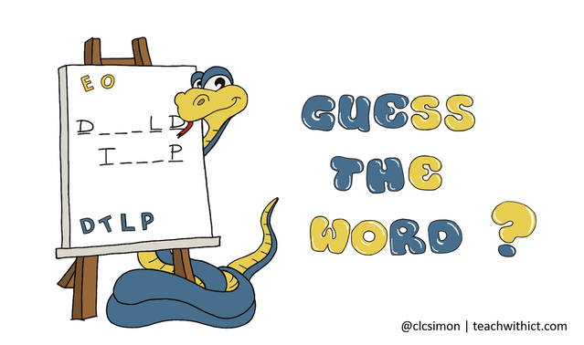
Guess-the-word!
Input each letter to successfully guess the unknown word!
Developer: Chia Lin
URL: https://github.com/clin19/Guess-the-word

